Slide 1

ASSISTANCE FOR ANHYDROSIS PATIENTS
INTERNET OF THINGS
VARSSHA BALASUNDARAM(210701325)
KEERTHANA H(210701117)
KEERTHANAA SP(210701325)

Slide 2
ABSTRACT
This project showcases an Arduino-based automatic room temperature control system that uses a temperature sensor to monitor the environment. Next, to provide a comfortable and energy-efficient environment, the Arduino adjusts the speed of a coupled DC fan motor based on the difference between the temperature that is sensed and a user-defined objective. Subsequent versions could look into different microcontrollers for possible large-scale manufacturing and integrate smartphone features, enabling companies, households, and individuals suffering from conditions like anhidrosis—which prevents them from sensing a room's temperature rise—to utilize this technology. It provides a more complete comfort solution than only fan based temperature control by adding humidity control. With the use of specialized sensors, the system continuously checks the temperature and humidity.
2

Slide 3
INTRODUCTION
The huge network of physical objects integrated with sensors, software, and other technologies that communicate and share data with one another over the internet is known as the Internet of Things (IoT). This makes it possible for everyday objects to collect and share data, such as refrigerators and thermostats. Consider a temperature sensor that can control the fan speed. It would also read the temperature and help with cooling. Just a small sample of the potential of IoT is provided here. The Internet of Things has several advantages. Task automation, improved efficiency across industries, and real-time data collection for informed decision-making are all made possible by it.
3

Slide 4
LITERATURE SURVEY
In [1], according to government recommendations 1, we may save 6% on energy costs by raising the temperature of any air conditioner by 1 degree. This study produced an affordable Internet of Things edge device that can be placed next to any air conditioner and will send out infrared signals to automatically set the temperature to twenty-four degrees.
In [2],This study offered an unmatched approach and execution for controlling room temperature and automatically adjusting the pace of an electric heater. Several types of relay-dependent analog circuitries were employed prior to the application of contemporary clever technology to create smart room heaters and automation systems.
The study in [3], study describes a system for BP neural network-based sensor position optimization that includes a PC, microcontrollers, data transmission units, and digital temperature and humidity sensors. Experiments are conducted to verify the system, and the findings indicate that the relative humidity standard deviation is ± 0.5%RH and the temperature standard deviation is ± 0.3oC
.
2

Slide 5
PROBLEM STATEMENT
It can be quite difficult to keep an indoor environment that is both comfortable and well, particularly in regions with high temperatures. Conventional techniques frequently depend on manually adjusting fans or thermostats. These methods can be inaccurate and ineffective, which might result in uncomfortable temperature fluctuations. For those who suffer from anhidrosis, a disorder in which the body finds it difficult to sweat and regulate body temperature through sweating, this is particularly worrying. Anhidrosis can result in a sharp increase in core temperature, thus it's important to take in cold, idealized humidity for comfort and health.
2

Slide 6
PROPOSED SYSTEM
The suggested method makes use of the Internet of Things (IoT) to provide a way to monitor temperature remotely. The brains of the system are microcontrollers such as Arduinos, which gather information from temperature sensors (such the DHT11) that sense the ambient temperature. The microcontroller then formats and processes this data. The suggested solution uses a wired Internet of Things architecture to track local temperature. The temperature of the environment is continuously measured by the sensor, and the microcontroller formats and processes the data. After that, the serial monitor in the Arduino IDE is used to show this data locally. We also use a humidity sensor to keep track of the current enivornment.
2

Slide 7
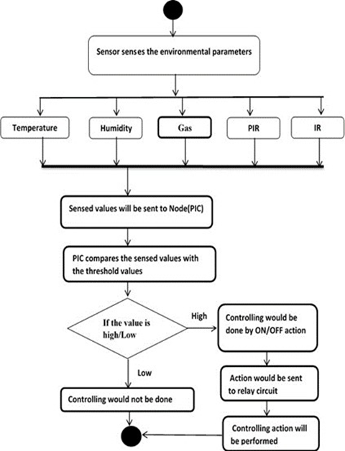
SYSTEM ARCHITECTURE

Slide 8
METHODOLOGY
Temperature and humidity sensors utilize various methods to convert these environmental factors into electrical signals. Resistive Temperature Detectors (RTDs) and thermistors measure temperature by detecting changes in resistance with heat, with RTDs offering higher accuracy and thermistors boasting higher sensitivity. Thermocouples, on the other hand, rely on voltage generation at the junction of dissimilar metals due to temperature differences. Humidity sensors come in various forms: capacitive sensors measure moisture absorption in a material, resistive sensors detect changes in resistance of hygroscopic materials, and optical sensors use light interaction with water vapor. Choosing the right sensor depends on your needs for accuracy, operating temperature range, cost, and response time. Remember, calibration, signal conditioning, and integration with data acquisition systems are often crucial for effective sensor usage.
4

Slide 9
RESULT AND DISCUSSION
The independent temperature control system prototype's first testing shows that temperature measurements may be used to successfully manage fan speed. The system efficiently creates a response system that controls temperature within a specified range by adjusting fan speed using Pulse Width Modulation (PWM).
The restriction of conventional techniques, which frequently depend on manual adjustments or fixed fan speeds, is directly addressed by this functionality.The system's effectiveness can be affected by elements like as the location of the sensors, the size of the space, and external heat sources. To reach the specified
temperature range consistently and optimize fan speed modifications, the control algorithm may need to be calibrated using real-world testing data. The restriction of conventional techniques, which frequently depend on manual adjustments or fixed fan speeds, is directly addressed by this functionality.The humidity sensor in the prototype is successfully employed to identify changes in the amount of moisture present in the surrounding air. In order to provide people with anhidrosis with a pleasant and maybe helpful environment, data collecting is essential.
5

Slide 10
CONCLUSION
The utilization of Arduino technology in the construction of an autonomous room temperature management system represents a noteworthy progress towards attaining comfort and energy efficiency in indoor settings. This system optimizes energy efficiency by utilizing temperature sensors and DC fan motors to provide a comfortable environment. In the future, upcoming versions might prioritize improving the capacity to handle larger workloads and making it easier for more people to use. Investigating alternative microcontrollers that are appropriate for large-scale production has the potential to optimize manufacturing procedures and lower expenses, therefore increasing the accessibility of this technology to both enterprises and homes. Incorporating smartphone capabilities would allow for remote monitoring and control, hence improving ease and usefulness. The potential utilization of this technology goes beyond just providing comfort, and instead provides substantial advantages to those with certain health issues such as anhidrosis.
6

Slide 11
REFERENCES
S. Sharma P. Randhawa, "IoT-Powered AC Temperature Management for Eco-Smart Infrastructures," 2024 2nd International Conference on Intelligent Data Communication Technologies and Internet of Things (IDCIoT), Bengaluru, India, 2024, pp. 59-63, doi: 10.1109/IDCIoT59759.2024.10467797. keywords: {Temperature sensors;Temperature measurement;Energy consumption;Temperature distribution;Costs;Power demand;Energy efficiency;IoT;AC-Energy Efficiency;Temperature},
F. Sharmin et al., "Humidity Based Automated Room Temperature Controller Using IoT," 2019 Third International conference on I-SMAC (IoT in Social, Mobile, Analytics and Cloud) (I-SMAC), Palladam, India, 2019, pp. 226-231, doi: 10.1109/I-SMAC47947.2019.9032624. keywords: {Temperature sensors;Humidity;Temperature measurement;Heating systems;Liquid crystal displays;room temperature;humidity;IoT},
N. Mubarakah, Soeharwinto and F. Iddha, "Prototype An ESP32-Based Room Humidity and Temperature Controller With IoT," 2022 6th International Conference on Electrical, Telecommunication and Computer Engineering (ELTICOM), Medan, Indonesia, 2022, pp. 121-126, doi:

Slide 12
THANK YOU

